Slide 1
Week 3 Update
29 January 2021
Notes:
Easy work flow for translating motion capture marker info into the model and making the model use it as input kinematics
TODO: share github with Justin, send trial vids
Advice from adrian: find a way to automate through MATLAB so we lose a fear of exploring

Slide 2
Agenda
Recap
Updates on marker positions
OpenSim crash course
Updates on running a simple model!
Updates on finding joint angles
Updates on finding ground reaction forces
Next steps
CC

Slide 3
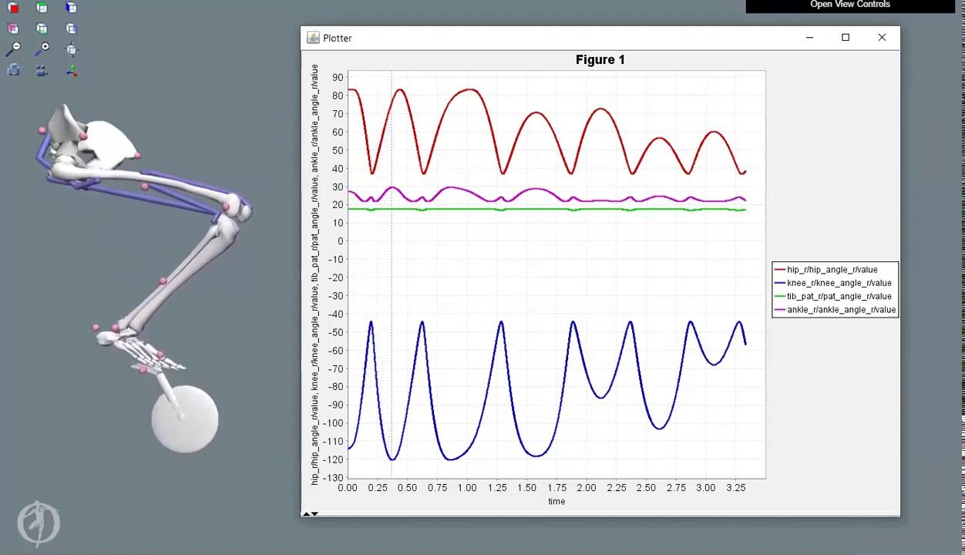
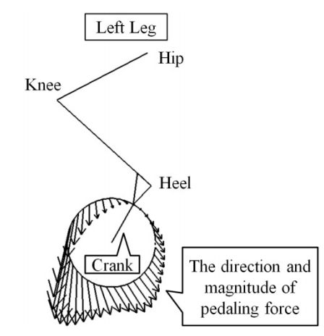
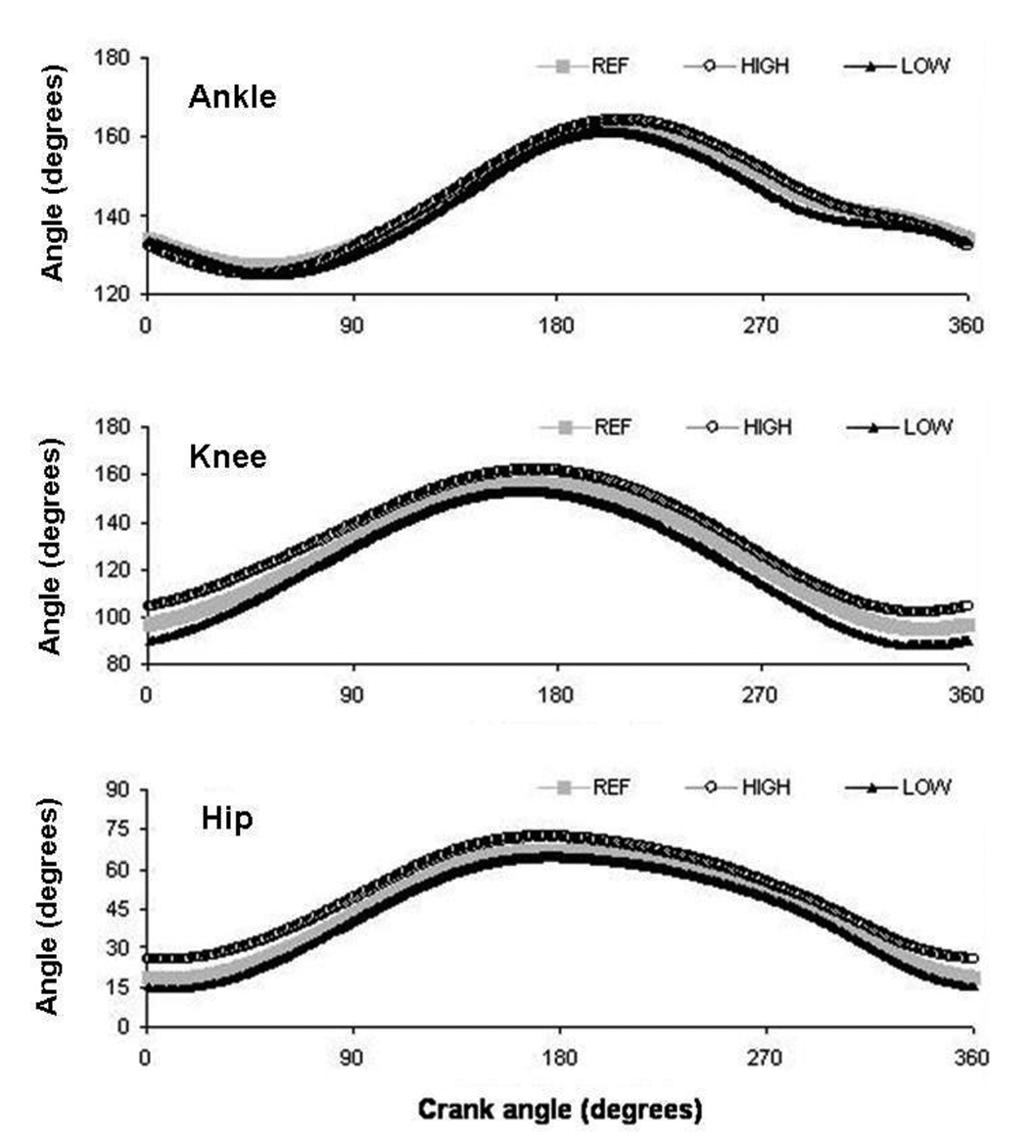
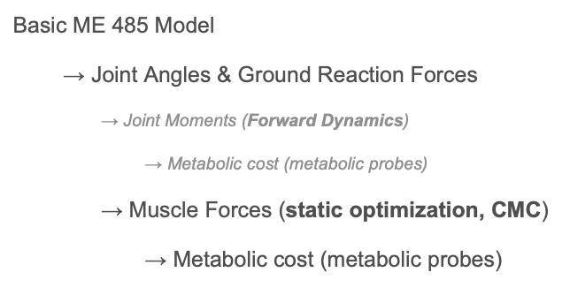
Recap
Stanford course (ME 485) project model
Limitations → simplification
External forces & joint angles literature review
Joint angles: Bini 2010, Bini 2014
GRF: Bini 2013
Workflow:
CC

Slide 4
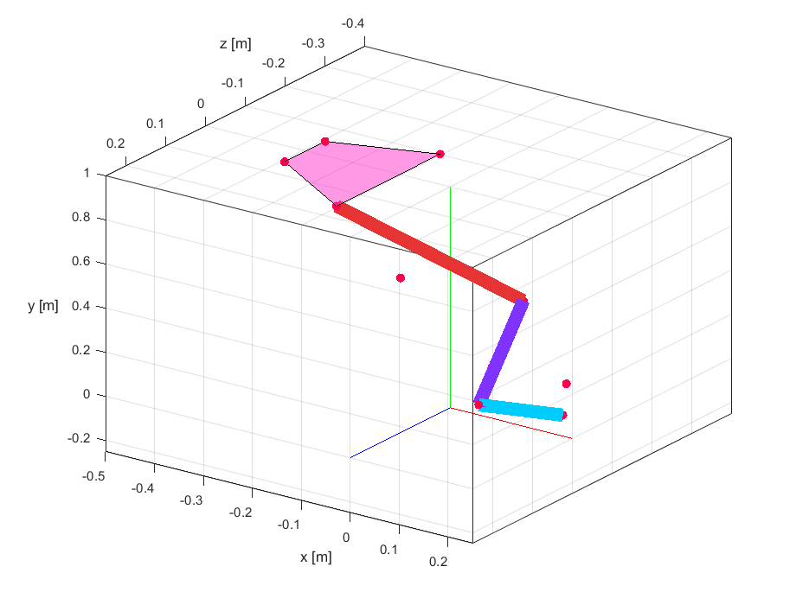
Markers’ Positions
Pelvis
RASI, LASI, RPSI, LPSI
Femur_r
RTHI, RKNE
Tibia_r
RTIB, RANK
Foot
RHEE, RPED, RTOE
DG

Slide 5
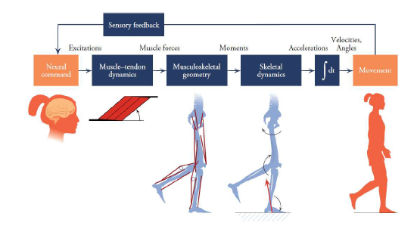
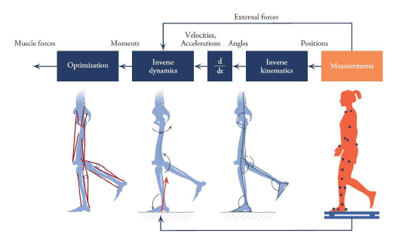
Forward Dynamics (L) vs. Inverse Dynamics (R)
Source: Figure 1.12 and Figure 1.13 Biomechanics of Movement: The Science of Sports, Robotics, and Rehabilitation by Thomas K. Uchida and Scott L. Delp (2020)
DG

Slide 6
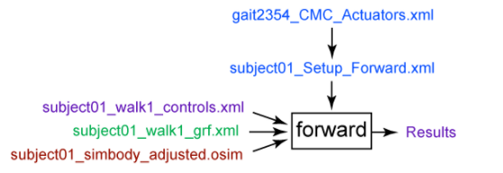
OpenSim Crash Course
Forward Dynamics
The Forward Dynamics Tool is used to calculate joint kinematics based on assumed muscle activations.
Simplest tool
Downside: Muscle activations assumed.
https://simtk-confluence.stanford.edu/display/OpenSim/Getting+Started+with+Forward+Dynamics
Inputs: Muscle excitation w.r.t. time, constraints on bodies’ coordinates (e.g. pelvis xyz-position, foot-on-pedal)
Outputs: Can obtain a wide array of outputs while muscle activation drives the simulation. Most useful will typically be joint angles, muscle-fiber lengths, and other body kinematics.
DG
Notes:
The purpose of inverse kinematics (IK) is to estimate joint angles from experimental data. The purpose of inverse dynamics (ID) is to estimate forces & moments.
CMC is likely our primary tool for obtaining the relevant muscle forces with a well defined trajectory (joint angles) and external loads (pedal reaction forces)

Slide 7
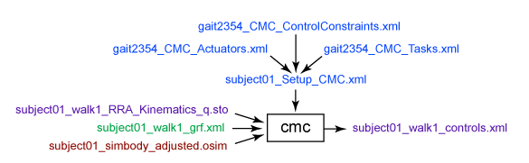
OpenSim Crash Course
CMC Tool (Computed Muscle Control)
The CMC tool is used to calculate muscle excitations based on desired kinematic inputs under various constraints/ boundary conditions.
Difficult to obtain convergence/ optimization
https://simtk-confluence.stanford.edu/display/OpenSim/Getting+Started+with+CMC
Inputs: Kinematics (joint angles, translations), coordinate tracking requests, constraints, actuation, GRFs
Outputs: Muscle activation forces, muscle activations/controls, muscle states of motion (joint angles & velocities; muscle fiber lengths & activations)
Ability to request Metabolic Probes
CMC Tool incorporate principles from Inverse Kinematics (IK) & Inverse Dynamics (ID) workflows
CEC
Notes:
The purpose of inverse kinematics (IK) is to estimate joint angles from experimental data. The purpose of inverse dynamics (ID) is to estimate forces & moments.
CMC is likely our primary tool for obtaining the relevant muscle forces with a well defined trajectory (joint angles) and external loads (pedal reaction forces)

Slide 8
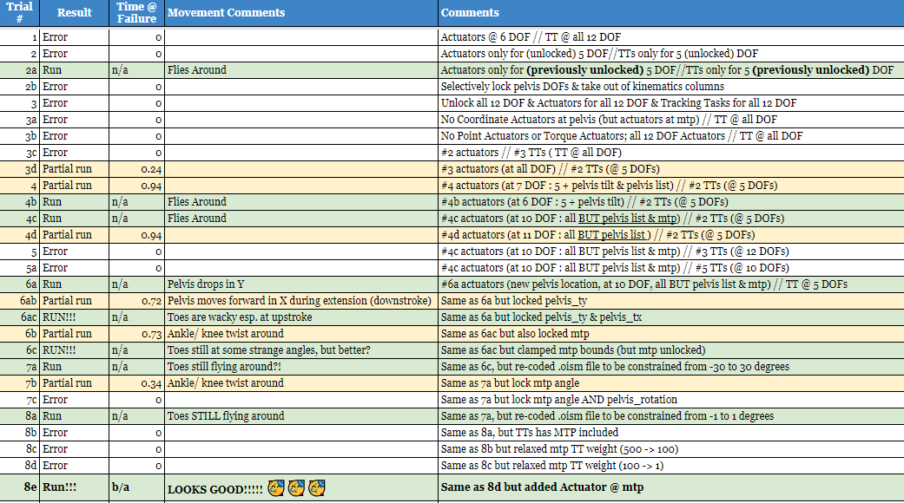
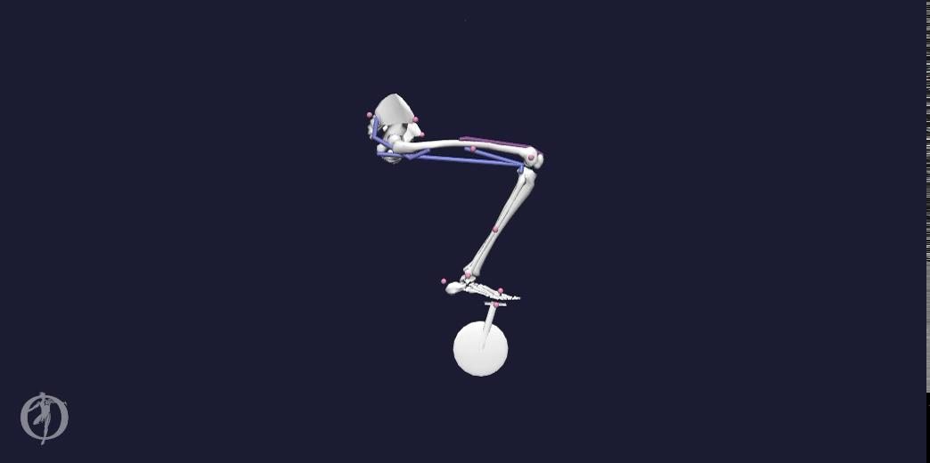
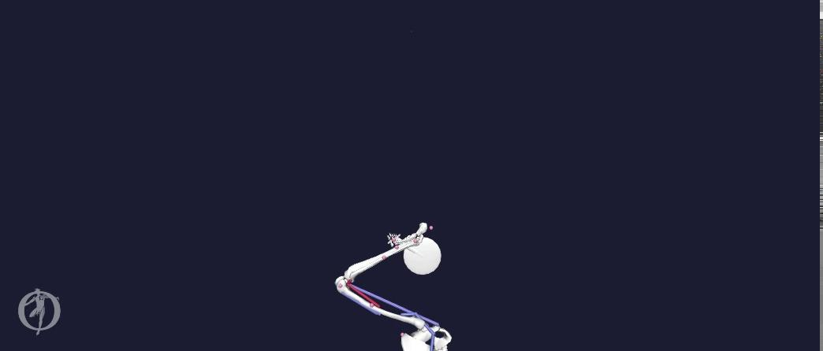
Trial Run Videos
Trial 2a
Trial 4c
Trial Tracker
Model successfully runs with CMC Tool with successful optimization to match kinematics but body motion is not correct.
CEC

Slide 9

Trial Run Videos (cont.)
Motion nears desired kinematics & dynamics with CMC tool. MTP (metatarsophalangeal) joint does not follow desired motion.
Trial 6c
CEC

Slide 10
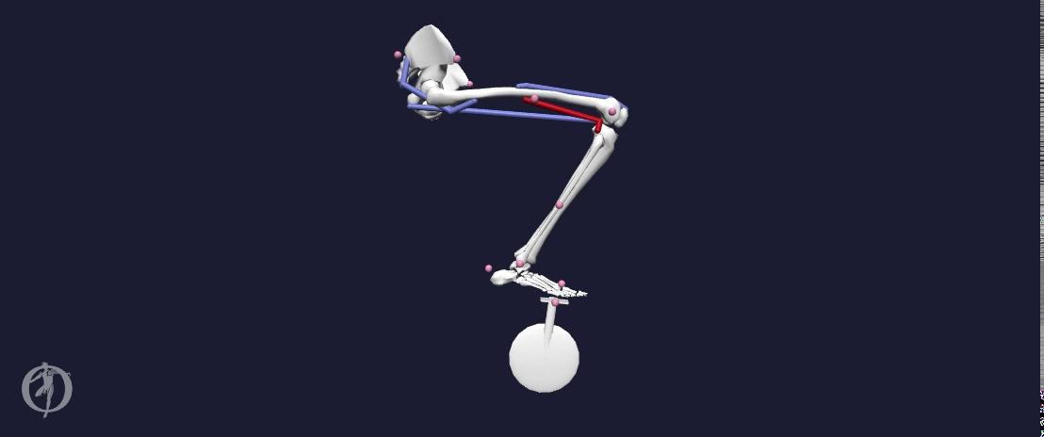
Trial Run Videos (cont.)
Success! Motion appears as desired with CMC tool.
Trial 8e
CEC

Slide 11
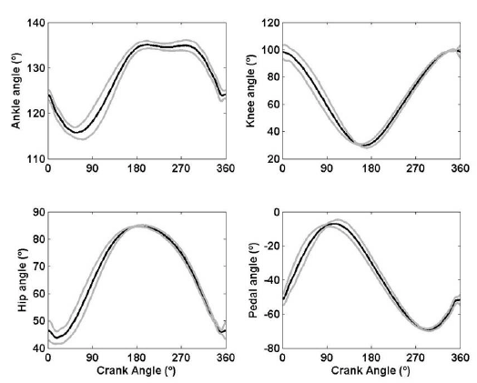
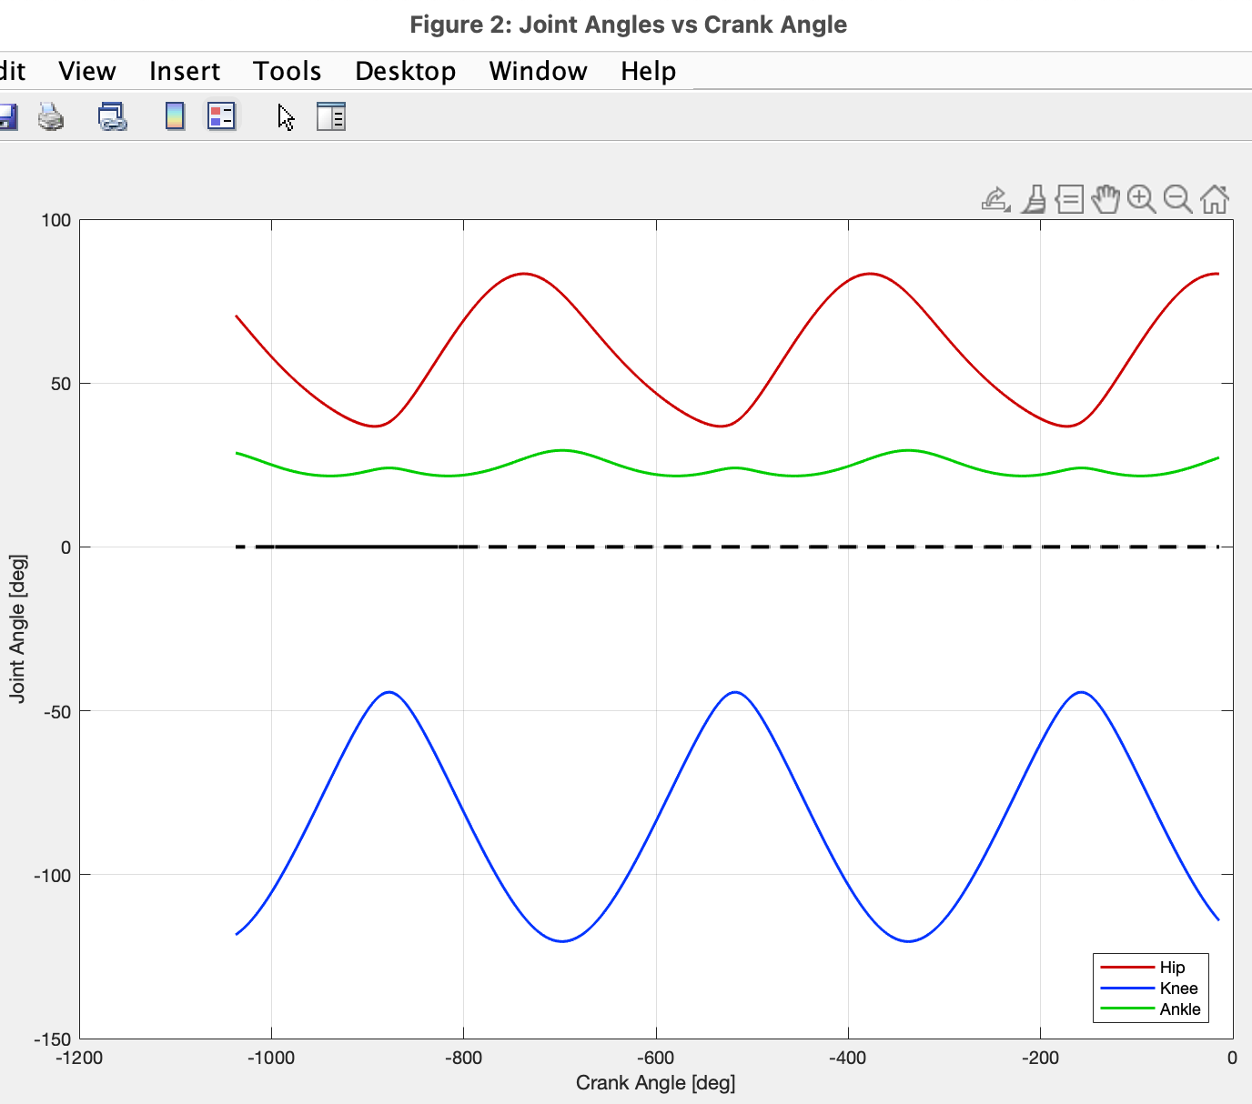
Model Joint Angles
Bini (2010)
Bini (2014)
ME 485 Forward Dynamics
CC
Notes:
*Need to double check reference points / conventions on how joint angles are measured in OpenSim vs how they are measured in referenced literature

Slide 12
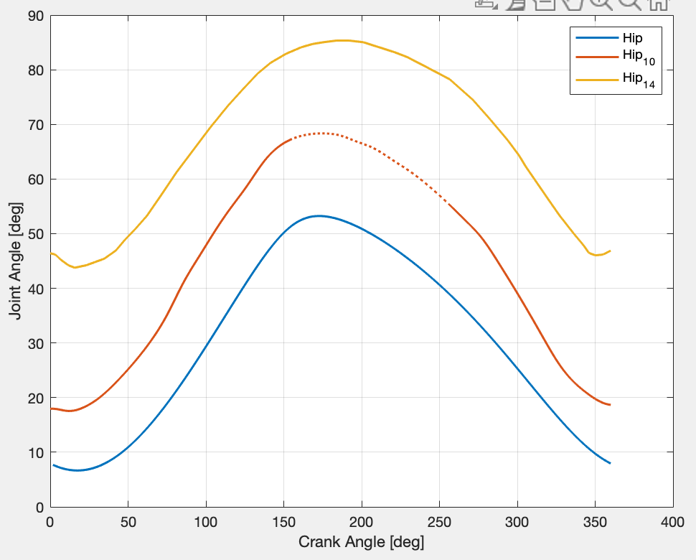
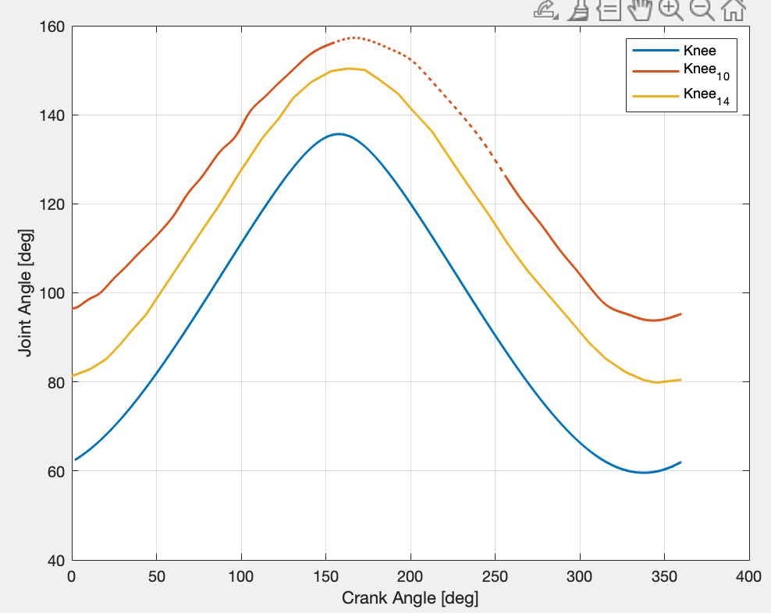
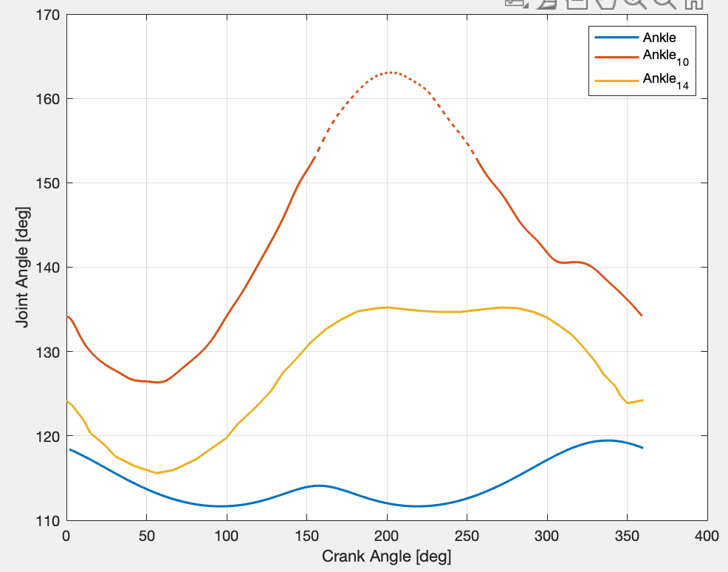
Model Joint Angles cont.
Hip Comparisons
Knee Comparisons
Ankle Comparisons
CC
Notes:
*Need to double check reference points / conventions on how joint angles are measured in OpenSim vs how they are measured in referenced literature

Slide 13
Model Joint Angles cont.
Hip Comparisons
Knee Comparisons
Ankle Comparisons
Bini 2010 Hip Angles
Bini 2014 Knee Angles
Bini 2014 Ankle Angles
CC
Notes:
*Need to double check reference points / conventions on how joint angles are measured in OpenSim vs how they are measured in referenced literature

Slide 14
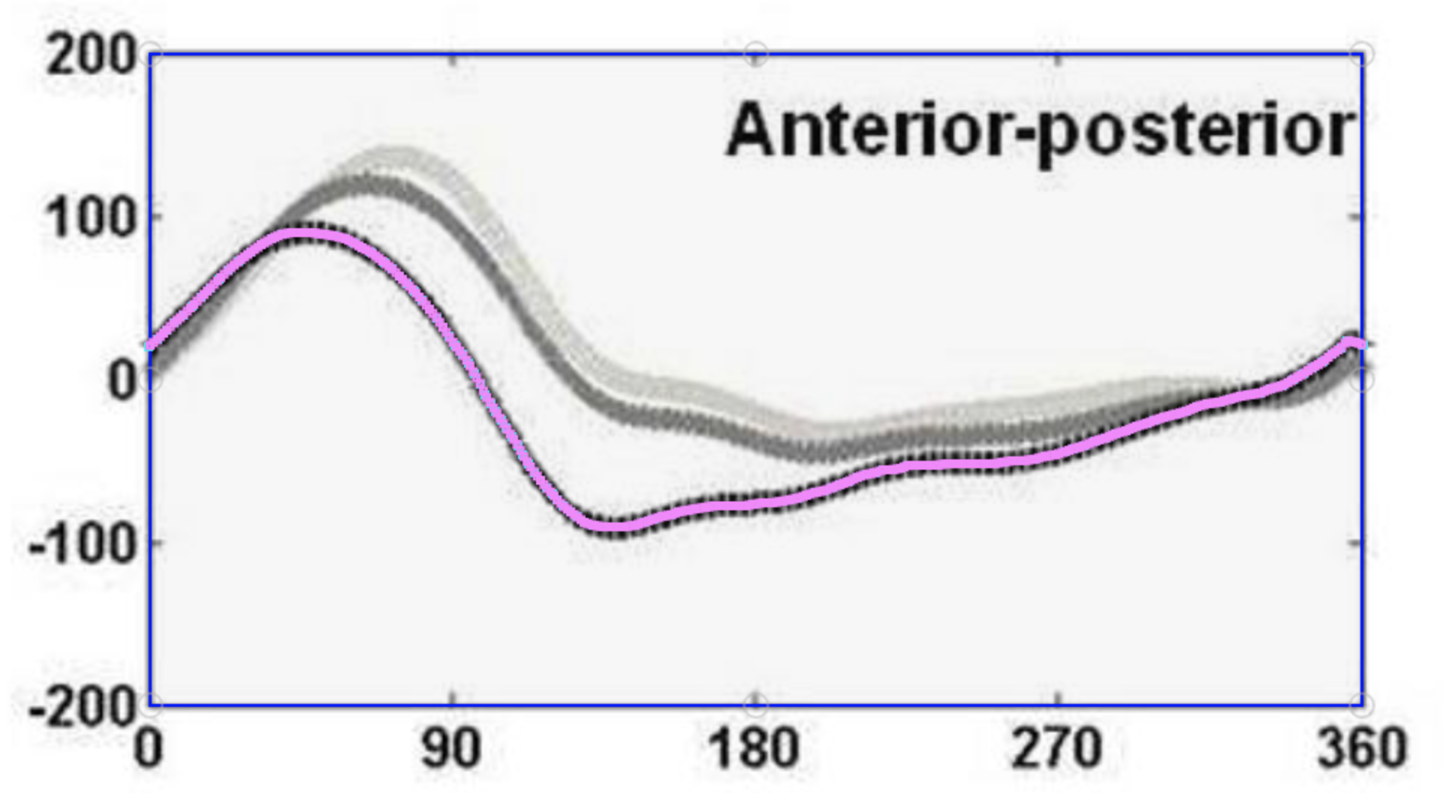
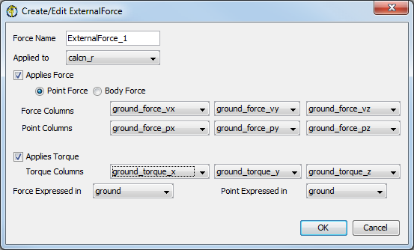
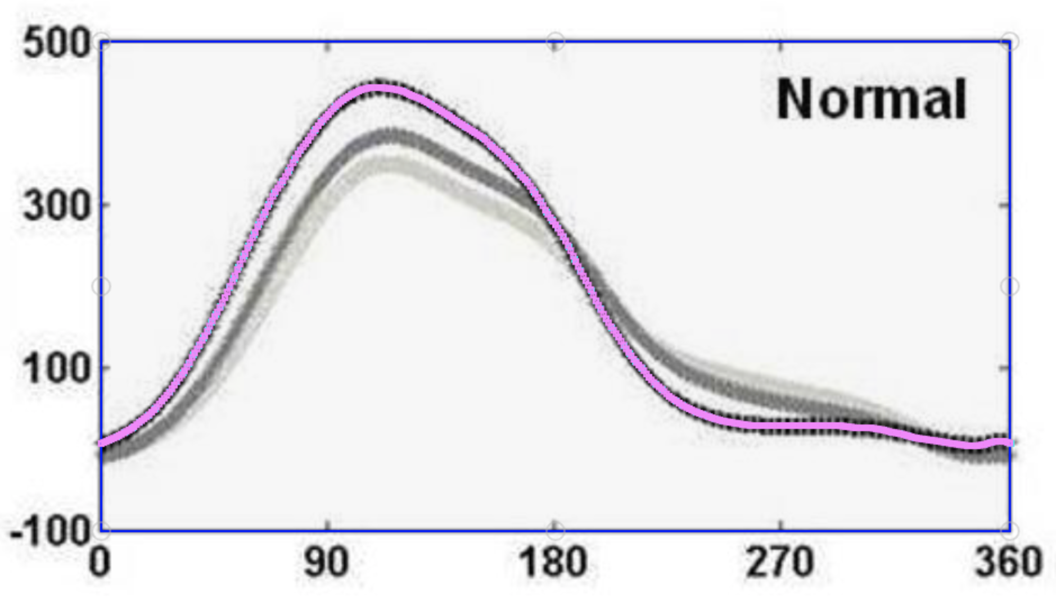
External Forces on Model
OpenSim External Forces Tutorial
Yamashita (2013)
SR
Bini (2013)
Notes:
Foot and pedal interactions assuming clip will change the normal force on the foot….how should we incorporate this?

Slide 15
Recall
Joint angles
GRFs
SR
Notes:
*Need to double check reference points / conventions on how joint angles are measured in OpenSim vs how they are measured in referenced literature

Slide 16
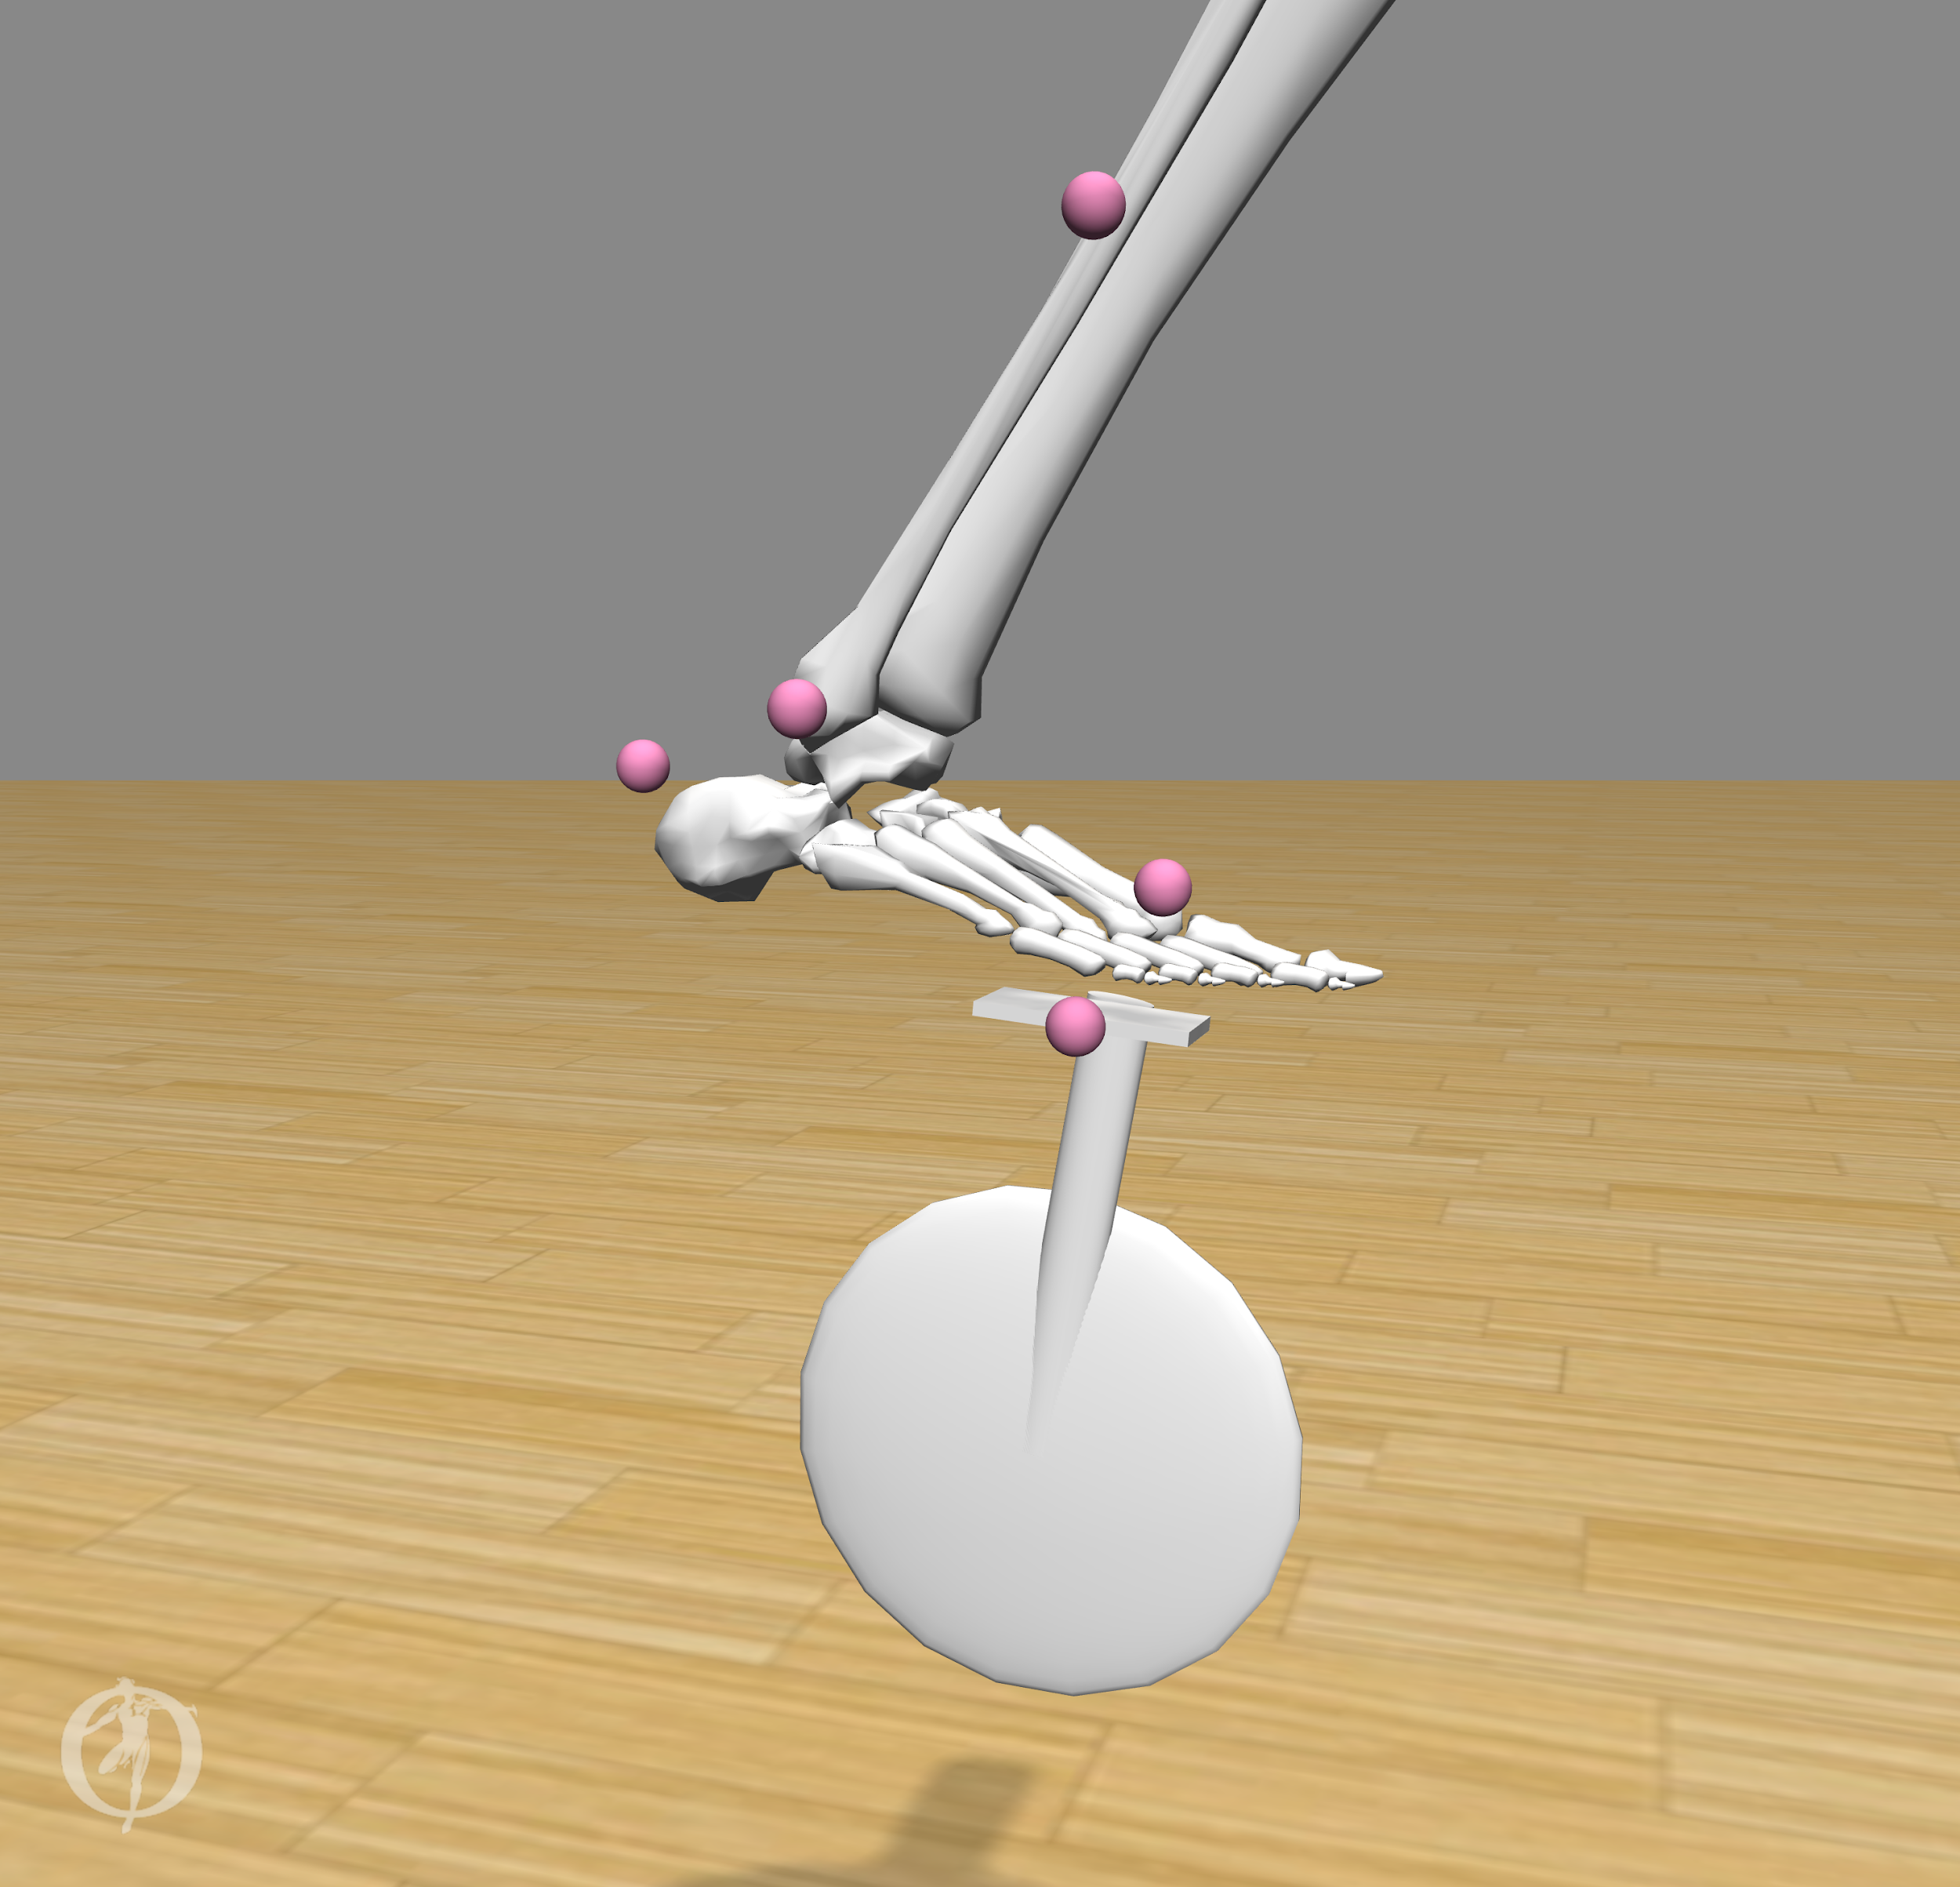
Stanford Course Model Drawbacks
Stanford Course model does not reflect an accurate foot-to-pedal interaction (due to an offset)
The bike pedal angle with respect to the ground is not constrained accurately
The ankle angle is not parameterized anywhere on the model
SR
Notes:
Advice from adrian: we can think about foot pedal gap as a minor issue, and can be like a shoe essentially

Slide 17
Next Steps
Fine tune OpenSim specific input files (actuator file (.xml), tracking tasks (.xml), setup load file (.xml), kinematics (.sto))
Create & integrate current OpenSim model with literature-based pedal forces (.xml / .mot)
Create & integrate current OpenSim model with literature-based joint angle data (.mot / .sto)
Adjust minor geometric details on model to accurately reflect set-up found in literature
Establish repeatable process workflow for models/analyses of increasing complexity
Improve on existing CMC analysis by incorporating metabolic probes
Continue to meet with OpenSim experts
SR

Slide 18
Timeline
Week 2 | Week 3 | Week 4 | Week 5 | Week 6 | Week 7 | Week 8 | Week 9 | Week 10
1/22 | 1/29 | 2/5 | 2/12 | 2/19 | 2/26 | 3/5 | 3/12 | 3/19
External forces
Joint angles
Create OpenSim files
Meet with OpenSim Experts
 | Compute muscle forces through CMC
SR

Slide 19
Questions/Asks
TBD
all
Notes:
Spring gauge on a crank - power crank
Professional versions output 200Hz
Literature is probably a better source than Specialized

Slide 20
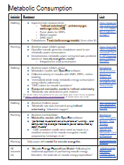
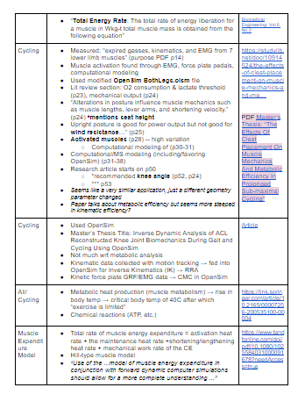
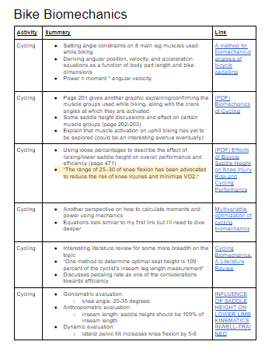
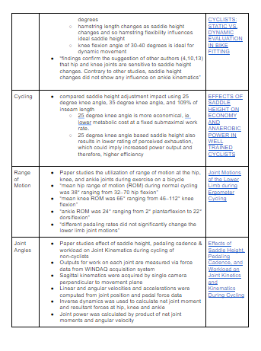
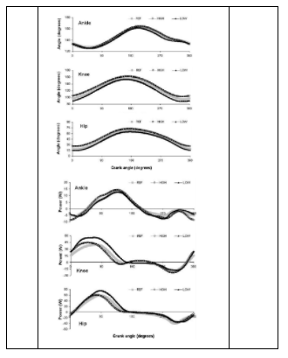
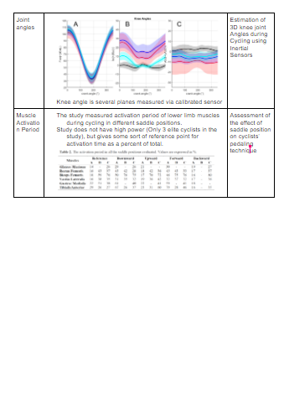
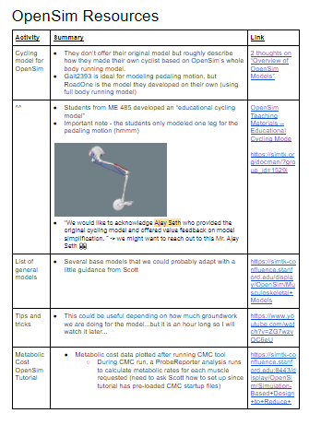
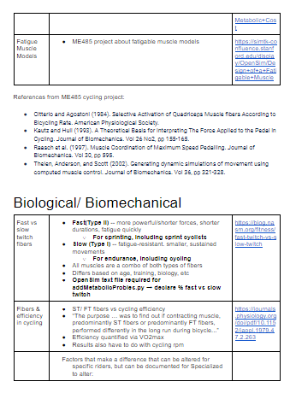
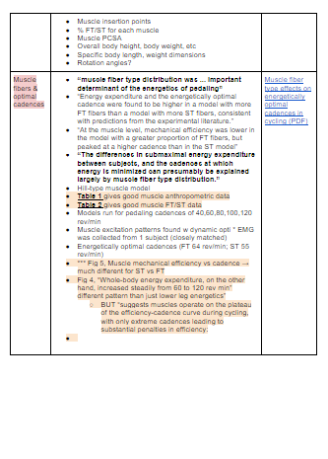
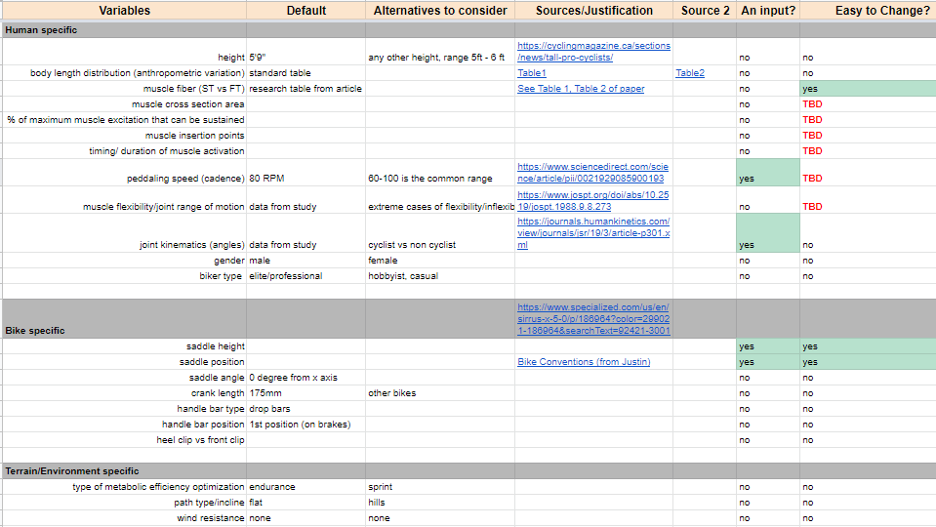
Information Gathering
Literature Review
Metabolic Consumption in movement
Bike Biomechanics
Biological/ Biomechanics
OpenSim (papers, resources)
Parameter Tracker
Consulted OpenSim experts
Scott Delp
Carmichael Ong
Ajay Seth
CEC

Slide 21
Problem Restatement
To create/propose a well-documented, proof of concept model and simulation workflow that calculates metabolic efficiency using biomechanics/OpenSim toolboxes
CEC
Notes:
From me329 website: The bicycle is the most energy efficient mode of human transportation. Even with that distinction, there is room for improvement. Significant work has been done to quantify metabolic efficiency changes resulting from relative human to bicycle fit changes. This type of testing works well for final validation but is time prohibitive to scan large design spaces or optimize across populations rather than individuals. As we search for optimal solutions it is critical to leverage simulation techniques to quickly quantify improvements for individuals and populations.
From last email: “The general idea in this study is that the fit for a rider is rotated about the BB. This keeps all of their joint angles constant but changes how their center of mass, the gravity vector, and the pedals align. See image below for how this fit rotation relates to the effective seat tube angle.”

Slide 22
Problem Constraints
OpenSim models require subject-specific motion capture (kinematics) and force capture (kinetics) for each individualized model to produce results with good fidelity
Process takes 2+ years (based on conversation with Stanford OpenSim expert)
Varying position (x,y) of saddle height requires entirely re-captured model, built from the ground up with original kinematics & kinetics in order to calculate metabolic output
In summary, OpenSim is inherently different from other simulation software (such as ANSYS) where it is simple to run a several iterations while altering a few parameters.
Optimization loops are not possible with OpenSim
CC
Notes:
From me329 website: The bicycle is the most energy efficient mode of human transportation. Even with that distinction, there is room for improvement. Significant work has been done to quantify metabolic efficiency changes resulting from relative human to bicycle fit changes. This type of testing works well for final validation but is time prohibitive to scan large design spaces or optimize across populations rather than individuals. As we search for optimal solutions it is critical to leverage simulation techniques to quickly quantify improvements for individuals and populations.
From last email: “The general idea in this study is that the fit for a rider is rotated about the BB. This keeps all of their joint angles constant but changes how their center of mass, the gravity vector, and the pedals align. See image below for how this fit rotation relates to the effective seat tube angle.”

Slide 23
Building on previous ME 485 Model
(2018) Stanford students created this one legged simple pedaling model.
We can use this as a springboard to start developing more realistic cadence and forces
DG
Notes:
DG

Slide 24
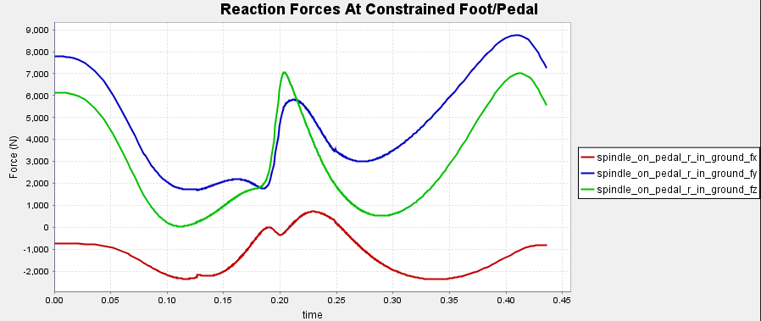
Limitations of ME 485 Model
Pedal constrained to foot → Unrealistic reaction forces
Position & dynamics inconsistent with literature
No motion capture data
No ground reaction force (GRF) at pedals
Only one set of Forward Dynamics input files
Little documentation
CEC

Slide 25
Workflow Proposal
Basic ME 485 Model
→ Joint Angles & Ground Reaction Forces
→ Joint Moments (Forward Dynamics)
→ Metabolic cost (metabolic probes)
→ Muscle Forces (static optimization, CMC)
→ Metabolic cost (metabolic probes)
DG

